Slide 1
Who i am?
Pataricza György
2 final exams to be a lawyer, but rather be a programmer
Worked as debt collector agent
https://github.com/pataricza

Slide 2
Buttons with thymeleaf
A journey of pain and joy

Slide 3

First impressions (few online information)

Slide 4
What i didn’t like in thymeleaf
Syntax
Syntax
Syntax
Syntax
Syntax
Syntax
But I’m starting to get used to it. ☺

Slide 5
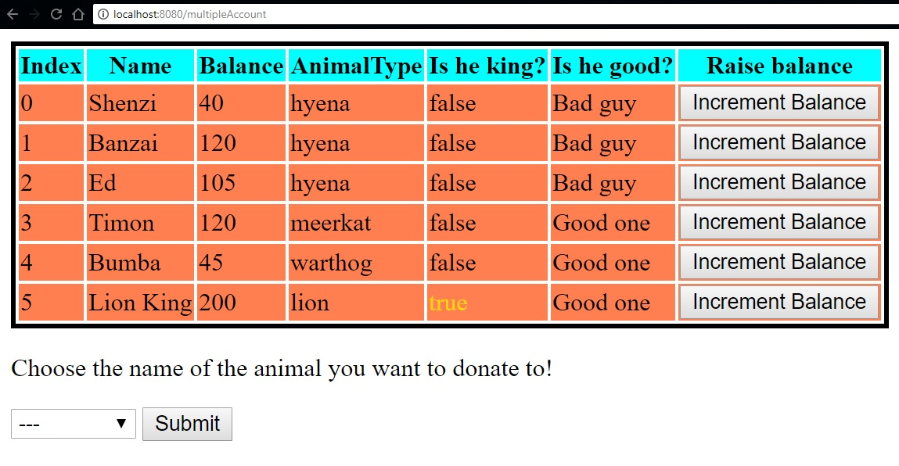
The result

Slide 6
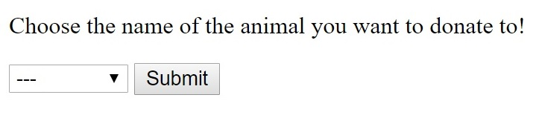
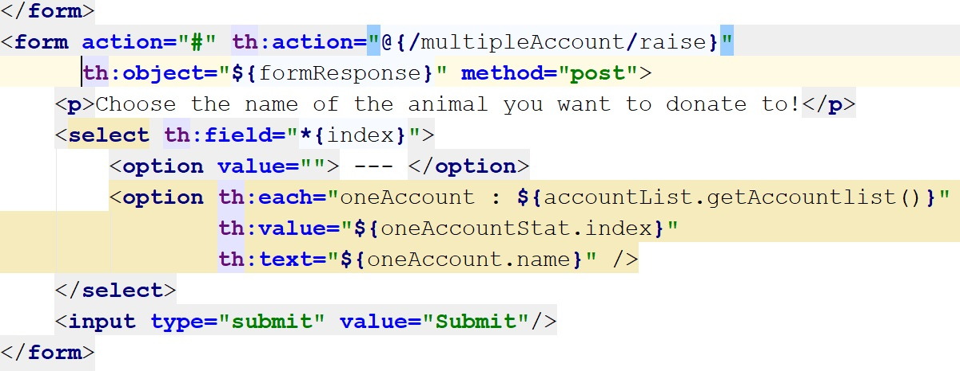

Slide 7
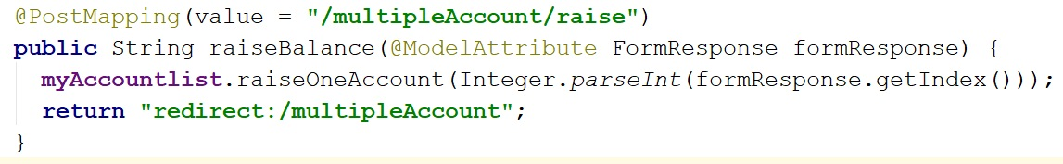
Controller

Slide 8
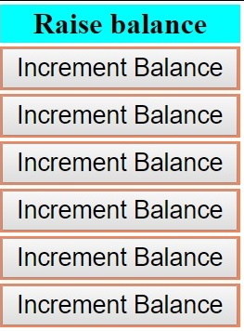

Slide 9
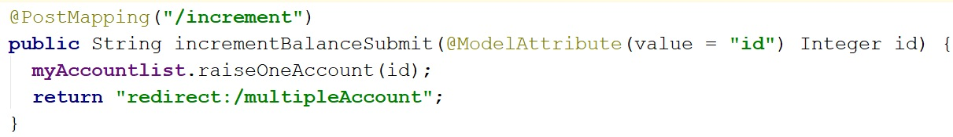
Controller

Slide 10


